Slide 1
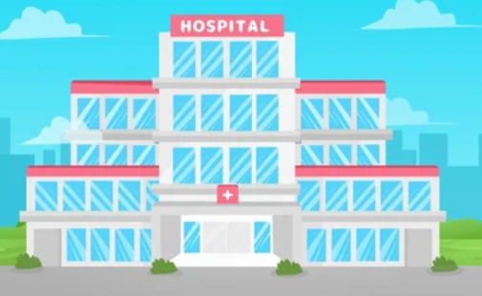
Power BI Project:
Columbia Asia Hospital
Submitted by : Rohit Mehra

Slide 2

Agenda
Problem Statement
Data Description
Objective Key Metrics and Visualizations
Subjective Question for Insights

Slide 3
The image above displays details about Columbia Asia Hospital data, including:
Date: This column contains date and time information without specifying AM or PM. The format is DD-MM-YYYY HH:MM.
Patient ID: Each patient is assigned a unique identifier, which seems to be in the format 124-62-3289.
Patient Gender: This column records the gender of the patient, denoted by 'M' for male and 'F' for female.
Patient Age: The age of the patients is listed in years.
Patient Sat Score: It seems to represent a satisfaction score given by or for the patient. However, the scores are single-digit, and it's not clear what the scale is.
Patient First Initial: This column contains the first initial of the patient's first name.
Patient Last Name: The surname of the patient is listed in this column.

Slide 4
Patient Race: The racial or ethnic background of the patient is recorded here, with categories such as 'White', 'African American', 'Asian', 'Native American/Alaska Native', and 'Two or More Races'.
Patient Admin Flag: This column contains boolean values ('TRUE' or 'FALSE') which might indicate whether the patient was admitted or some other administrative flag.
Patient Wait Time: Appears to indicate the time the patient waited, possibly in minutes, before being seen or processed.
Department Referral: This column lists the department to which the patient was referred, with entries such as 'General Practice', 'Orthopedics', 'Gastroenterology', or 'None' indicating no referral.
Doctor Name: Identifies the doctor who attended each patient.
Appointment Fees: The cost charged for a doctor's consultation.
Total Bill: The overall amount billed to the patient, including all services and charges.

Slide 5
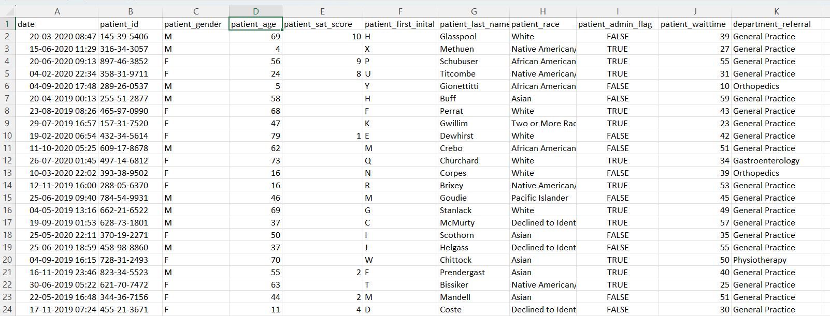
Problem Statement
You have been hired as a consultant data analyst by Columbia Asia Hospital. The Hospital is looking for key insights for the following objectives:
Assess the hospital's revenue generation
Insights about suitable departments for new hires
Strategies suggestions for patient discounts
Task is to perform data analysis and come up with a report in order to help the organisation with the mentioned objectives.

Slide 6
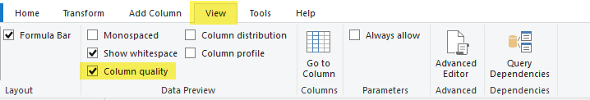
Objective Questions
In analyzing the hospital dataset with Power BI, ensure data cleaning to address inconsistencies and missing values before further analysis.
Data cleaning is crucial for accurate analysis.
Identifying Inconsistencies, Handle Missing Value Remove Duplicates are one of the options.
In order to ensure the data cleaning to address the inconsistencies and missing values , we have load the data in the power BI and selected the option “Transform Data” to open it in the power query editor .
In Power Query editor we have routed to view option and add the column quality.
We have removed the null values from there if it’s not 100% valid, we have removed the null values and verified the column quality as 100%.
We have removed the null values from here.

Slide 7
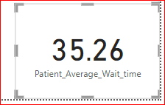
Objective Questions
Assess the Average Waiting Time: Analyse the patient wait times to identify the average duration a patient spends before receiving care.
We have assessed the average waiting time by creating a new measure in the sheet “Hospital ER”.
Patient_Average_Wait_time = AVERAGE('Hospital ER'[patient_waittime])

Slide 8
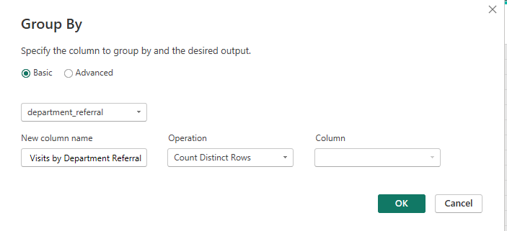
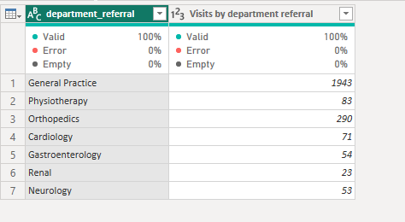
Objective Questions (Cont..)
3. Visits by Department Referral: Calculate the total number of visits to each department based on referrals to understand which departments are most frequently visited.
In Power Query Editor , we have transformed the data by grouping it with department types and fetched the required information.
General Practice is the department which is frequently visited

Slide 9
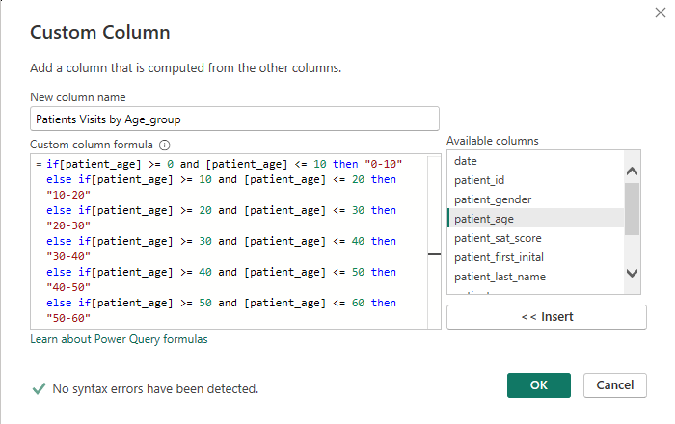
Objective Questions (Cont..)
Patient Visits by Age Group: Segregate patient visits according to different age groups to see which demographics utilize healthcare services the most.
We have created a custom column in order to segregate the patients with different age-groups.

Slide 10
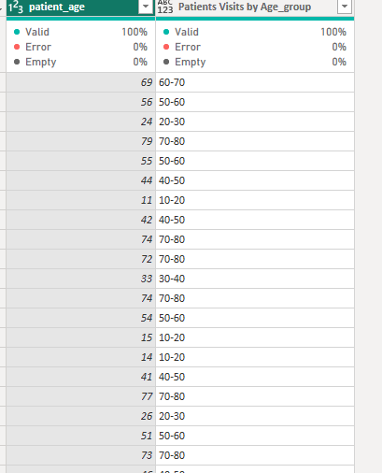
Objective Questions (Cont..)
By doing this , it has created a new column which states if the patient age is 33 , he will be falling under Age group 30-40.
Then we have selected the “Group by” for this new Custom column “Patients Visits by Age_group” which has provided us the desired results.

Slide 11
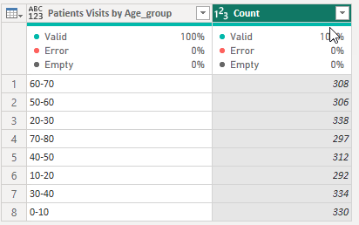
Objective Questions (Cont..)
As we can see patients in the range of 20-30 are highest so we can conclude that the
Patients with age groups ranging from 20-30 visit the hospital most.

Slide 12
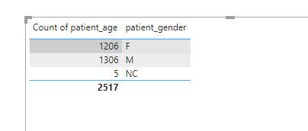
Objective Questions (Cont..)
5. Were there any Null values in the data? What would be the best way to handle these Null values and which approach have you opted?
Yes there were Null values in the data. Handling null values in a dataset is essential for accurate analysis. There are number of ways through which we can handle null values :
Remove Rows , Conditional Fill, Flagging Null Values
We have removed those by filtering them out.
6. Is there any relation between the number of visits and Gender of the patients.
As per the data , there were more male patients than Female. We have used the table visual here.
Furthermore , we can categorize it by age group as well as we already have the age group column.

Slide 13
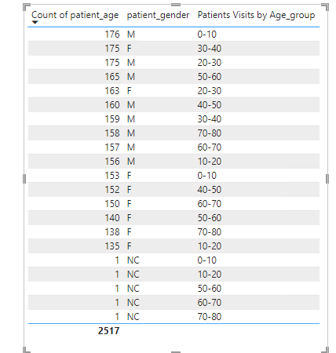
Objective Questions (Cont..)
Now we can conclude that there are more male patients than females.

Slide 14
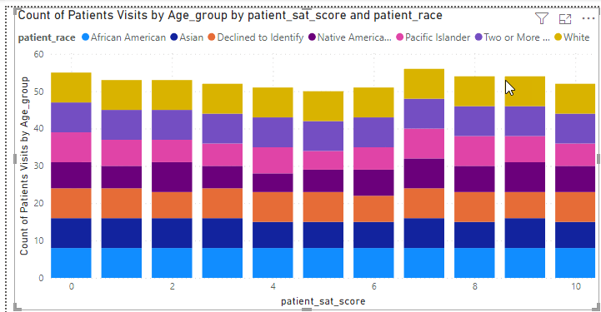
Objective Questions (Cont..)
7. Average Satisfaction by Demographics: Determine the relationship between patient satisfaction scores, their age groups, and racial backgrounds to pinpoint areas for improvement in patient experience.
As we have already created the required measures using DAX functions .We have used the Stacked column chart here to determine the relationship between patient satisfaction scores, their age groups, and racial backgrounds as we are already having this data beforehand

Slide 15

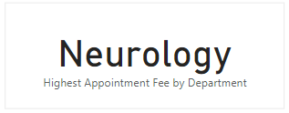
Objective Questions (Cont..)
Using ‘Calculate’ and a row iteration DAX function calculate the total number of patients who have visited Dr. Smith
Patient visits Dr.Smith = CALCULATE(COUNTROWS(Sheet1),FILTER(Sheet1,Sheet1[Doctor Name]="Dr. Smith"))
9. Which department is charging the highest appointment fees in general? Use an aggregation DAX function to solve this question.
Neurology dept is charging the highest appointment fees.
Highest Appointment Fee by Department = SELECTCOLUMNS(TOPN(1,Sheet1,Sheet1[Appointment Fees],DESC),"Department",Sheet1[department_referral])
Create a tabular visualization in the Report view which consists of Month-wise total visits in the hospital. Add a third column in the table that consists of the previous month’s total visits for each month’s row. Also include a column which states whether the visits in a month is greater than that of previous month visits.

Slide 16
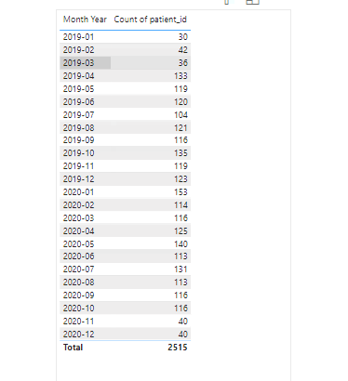
Objective Questions (Cont..)
We have created a new column for the Month and year using FORMAT(‘Date’,”YYYY-MM”) then created a tabular visualization for the same . The below table is indicating the count of patients in the particular month.
For PreviousMonth we have created a new column using formula PreviousMonthVisits = CALCULATE(COUNTROWS('Hospital ER'), PREVIOUSMONTH('Hospital ER'[date]))
We have removed the duplicates from Model view as well as from PowerQueryEditor but it’s giving us the error. I’ve tried it for few days but unable to solve it.

Slide 17
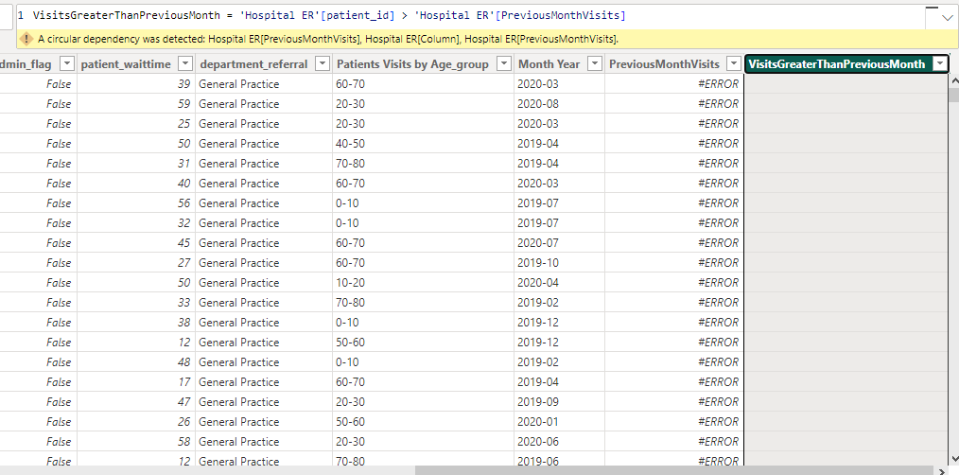
Objective Questions (Cont..)
Also to compare the current month and previous month ,we could have used the below column and add it in the tabular visualization but unfortunately we couldn’t find the previous months visits.

Slide 18
Objective Questions (Cont..)
So this is the final output.

Slide 19
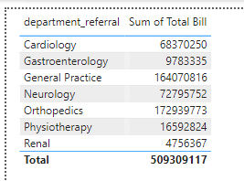
Objective Questions (Cont..)
The hospital's managing director seeks to evaluate the revenue of each department to understand how much revenue is generated by each.
We can use the table visualization here to find out the revenue of each department.
12. Calculate the average age of the patients who visit the Orthopedics department. Will the approach used to calculate this metric be different if the requirement would have been all department’s average age.
AverageAgeOfOrthopedics = CALCULATE(AVERAGE('Hospital ER'[patient_age]),FILTER('Hospital ER','Hospital ER'[department_referral] = "Orthopedics") And it’s giving us the result 39.03.

Slide 20
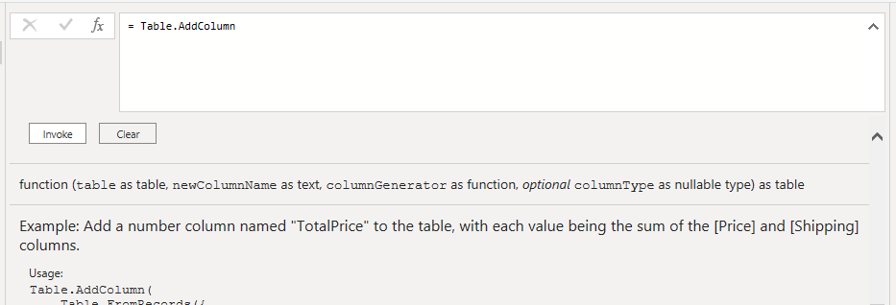
Objective Questions (Cont..)
Were there any data format issues in the data, and if there were/are how you handled them?
Yes , there is an issue in the date format . We can’t use the PreviousMonth function ,error stated there is duplicate values , removed those Still unable to do so .
When we add a column in Power Query what’s the code that comes in M language in formula bar? What do you know about M-query?
= Table.AddColumn(#"PreviousStep", "NewColumn", each [Column1] & [Column2])
M-Query represents the transformation applied in that specific step.
Power Query steps are cumulative ,so each step builds upon the previous.We can see it in the formula bar.

Slide 21
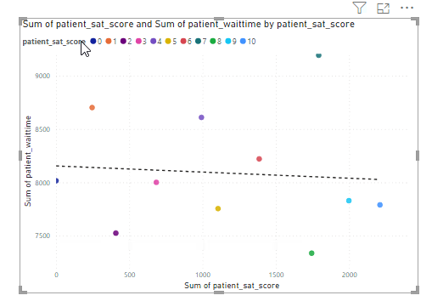
Data Analysis and Visualizations (Subjective Questions):
What is the relation between patient wait time and satisfaction scores Investigate whether longer wait times are associated with lower patient satisfaction across various departments.
In order to determine the relation between Patient’s Wait-time and satisfaction score, we have used the scatter plot. However we have aggregated it on the basis of sum as it’s not displaying the raw data.

Slide 22
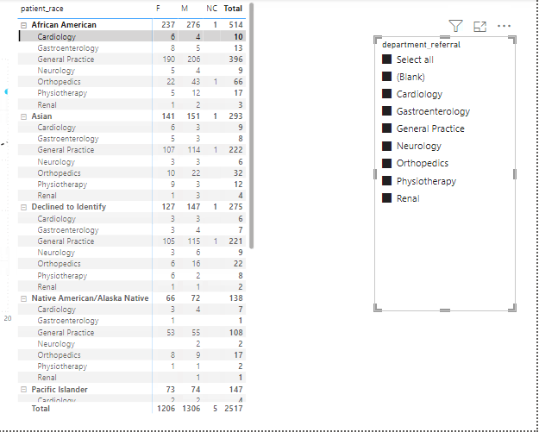
Data Analysis and Visualizations (Subjective Questions):
2. How do patient demographics affect the frequency of visits to different departments?Analyze visit patterns to see if certain age groups or races are more likely to be referred to specific departments.
Here we have used the matrix visualization and added different fields such as Patient’s age , Race, department referral and gender . Also we have added slicer as well to categorize.

Slide 23
Data Analysis and Visualizations (Subjective Questions):

Slide 24
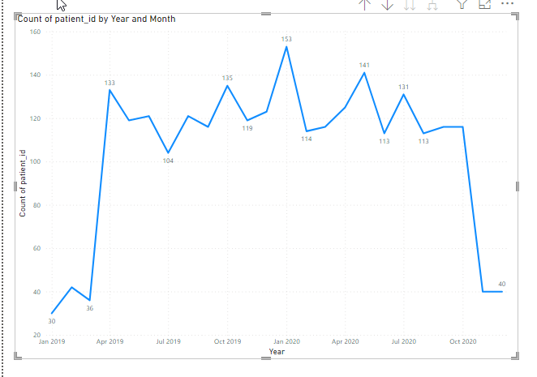
Data Analysis and Visualizations (Subjective Questions):
3.Is there a noticeable trend in the volume of patient visits throughout the year ? Examine patient visit data to identify any seasonal trends or particular months with increased healthcare facility usage.
We have used line chart here to check the trend , on one axis we have taken year and month and on another axis we took count of Patient ID and as we can see in the below chart , in Jan 2020 there are comparatively more patients.

Slide 25
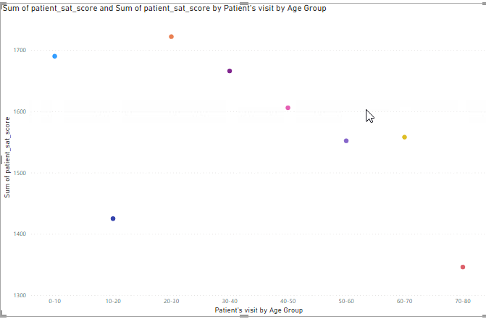
Data Analysis and Visualizations (Subjective Questions):
4.Which age groups report the highest and lowest satisfaction scores ? Calculate the average satisfaction scores within each age group to identify which age demographics report the best and worst experiences.
We have used scattered plot here and on x axis , we have used the age group which we created earlier and on Y axis we have took the sum of the satisfaction score.
As we can see it in the below chart.
Age group from 20-30 are having the highest satisfaction score.

Slide 26
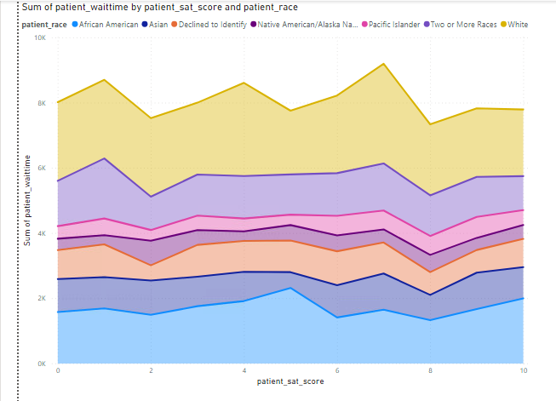
Data Analysis and Visualizations (Subjective Questions):
5.Say if someone outside of hospital claims that there is racial or gender based discrimination in the hospital, how will you identify whether the claim was right or not?
That can only be observed when we enter in the hospital. We shouldn’t pay much heed to such claims but if we hear such claims , even if we’re not paying much attention to it they will always be there in the back of the mind. For such claims we can use the data we have to verify if there is any truth or not .
We have used the Area chart and verified that the People with white race are having better satisfaction scores compared to African American which are at bottom . We can conclude here that , race based discrimination is definitely there.

Slide 27
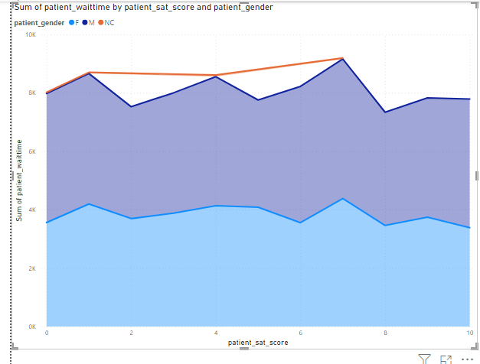
Data Analysis and Visualizations (Subjective Questions):
Also we have used the Gender on one axis and verified the patient’s satisfaction score. As we can see male are on top tier however females sum of satisfaction is comparatively below.
If we check the data of Total sum collected by patients and distribute them on the basis of race , it’s same as the satisfaction score.

Slide 28
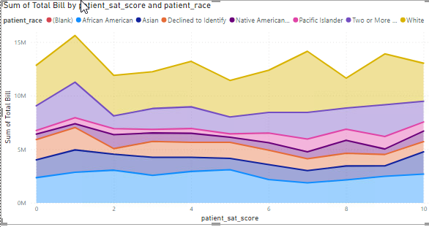
Data Analysis and Visualizations (Subjective Questions):
People with White race are having high satisfaction score also they are charged comparatively higher , this concludes that number of white race are higher which resulted in their higher satisfaction score as well as high total bill. Below is the data on the basis of total bill.

Slide 29
Data Analysis and Visualizations (Subjective Question) - (Cont…)
6.The hospital management intends to offer discounts to patients. The question arises: how should these offers/discounts be assigned to patients, on what basis, and why?
There are number of factors which hospital management have to look to offer the discounts/offers.
It can be on the basic of Financial need , suppose if a patient is poor and having critical condition but we don’t have the data here for the financial condition of the patients.
It can be based on the medical condition or the severity of the medical condition.
It can be based on the stay , if a patient is admitted in the hospital and his condition is somewhat where he/she has to stay for longer , that can also be counted as a factor.
It can be on the basic of Age, race or gender .
Frequent visits can also be considered as a factor here.

Slide 30
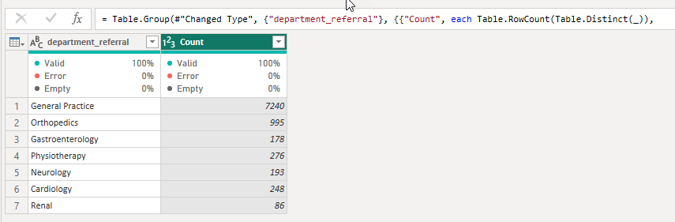
Data Analysis and Visualizations (Subjective Question) - (Cont…)
7.The hospital has a budget to hire 2-3 new doctors. They have asked for your suggestions in which departments they should hire.
As per our data , we have seen in above objective question #3 that there are many patients for the general practice (with null as well as not null values)
#With NULL Values

Slide 31
Data Analysis and Visualizations (Subjective Question) - (Cont…)
#Without NULL values
Also we have used the scattered chart over here to verify if we really need additional doctors for the general practice.
So we have looked at the patients wait-time and as we can see the patient visiting hospital for the general practice have to wait longer for the doctor comparative to other department. So we can hire additional doctor for the general practice if we are having a budget for the same .

Slide 32
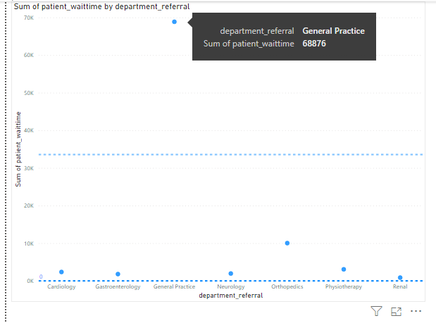
Data Analysis and Visualizations (Subjective Question) - (Cont…)
Below is the chart

Slide 33
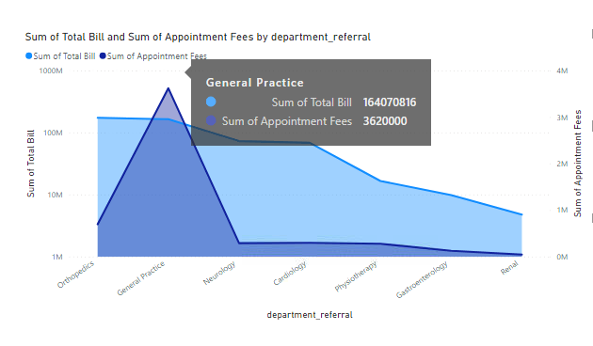
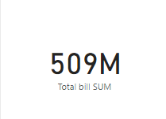
Data Analysis and Visualizations (Subjective Question) - (Cont…)
8. Is the hospital profitable? How will you determine the profitability?
We don’t have data where hospital is spending . We have only the data available for the total bill, appointment fee by department.

Slide 34
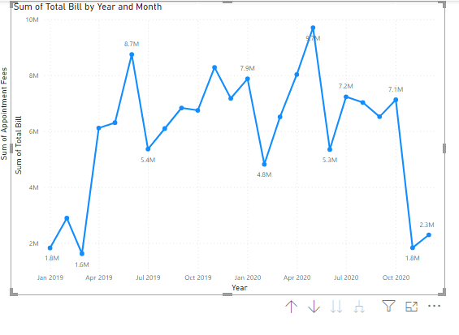
Data Analysis and Visualizations (Subjective Question) - (Cont…)
8. Is the hospital profitable? How will you determine the profitability?
Below is the line chart for the revenue of the hospital by Year and month and as we can see in May 2020 the revenue peaked.

Slide 35
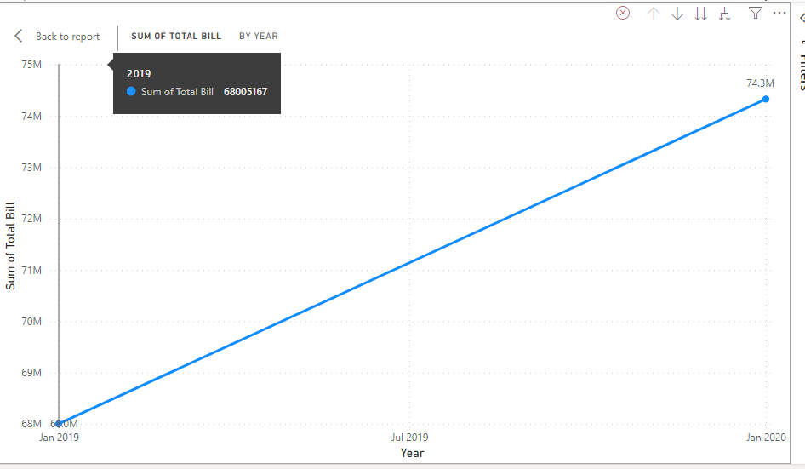
Data Analysis and Visualizations (Subjective Question) - (Cont…)
On the basis of the below chart we can say the hospital is profitable .

Slide 36
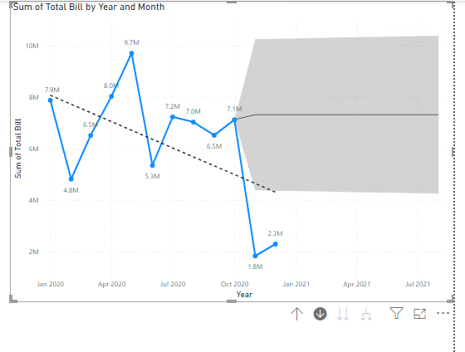
Data Analysis and Visualizations (Subjective Question) - (Cont…)
If we forecast it on the basis of the data provided , it will be the expected result.

Slide 37
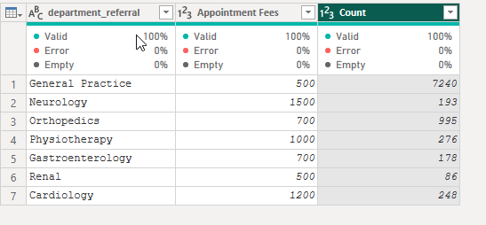
Data Analysis and Visualizations (Subjective Question) - (Cont…)
Any Department for which the waiting time is oddly large.
Yes, it’s for the General practice ,we have seen the data/chart in the subjective Question #7.
10. Come up with the strategies to provide discounts to the patients.
Designing effective strategies for providing discounts to the patients involves various factors.We have already discussed it in the subjective question #6.
Income based discount: Offer higher discounts to patients with lower income source to support their wellbeing also Neurology department is charging higher appointment fees , Discount can be given on the appointment fees as well for those patients.

Slide 38
Data Analysis and Visualizations (Subjective Question) - (Cont…)
Discount can be offered on the basis of the stay period in the hospital if the patient is admitted. We don’t have data for the stay period of the patient that’s why we couldn’t support this statement with the appropriate graph.
If a patient is availing multiple services then we can be offered some discount.
Frequent visit based : If a patient is visiting the hospital frequently then also he can be offered discount.
11. Say if you need to align the doctors of “General Practice” department to work in one of the two shifts, how will you identify what will these two shifts timings be, and how will you divide the doctors in these two shifts? And also will this 2 shift policy be helpful for the hospital?
As we have seen in the above questions , the patients visiting the hospital for the General Practice are comparatively very higher than other department.
The timings can be decided on the basis of the rush. During the day , the number of patients will be more so we can assign multiple doctors during the day and comparatively less number of doctors during the night.

Slide 39
Data Analysis and Visualizations (Subjective Question) - (Cont…)
The availability of the doctors will always be beneficial for the patients. They don’t have to wait for longer to see the doctor.
12. What do you understand by PowerBI gateway? What are its use cases?
The Power BI Gateway is an application that helps developers access data located within an on-premises network. The developers can choose from both cloud-based and on-premises locations when requesting their data.
Power BI has a 7.1 per cent market share amongst all Business Intelligence and Data Analytics platforms. This share is constantly on the up and owing to the wide suite of features it offers. Power BI Gateway is a powerful tool for integrating on-premises data with Power BI. Learn how to use Power BI Gateway to securely connect to data sources.
The Power BI Gateway tool is a software application that helps users access the required data residing in an on-premises network. The tool acts as a gatekeeper for the source of data, and any requests made by users to access the data from a cloud or web-based application go through this gateway. Users are granted access depending on their authentication and data needs.

Slide 40
Data Analysis and Visualizations (Subjective Question) - (Cont…)
It's important to note that the tool does not transfer any data from the on-location source to the user's platforms. Instead, the tool connects the data source to the platform directly, and the user or client can then access their data for creating reports and analysing data. The Power BI Gateway tool is also designed to establish connections between the data source(s) and the source on-location
Use cases :
Data Visualization
Business Reporting
Data Exploration
Real-time analytics
Self-Service BI
Data Consolidation
Predictive , Financial, Operational , Human Resources, Health Case and various other Analytics
Data Collaboration

Slide 41
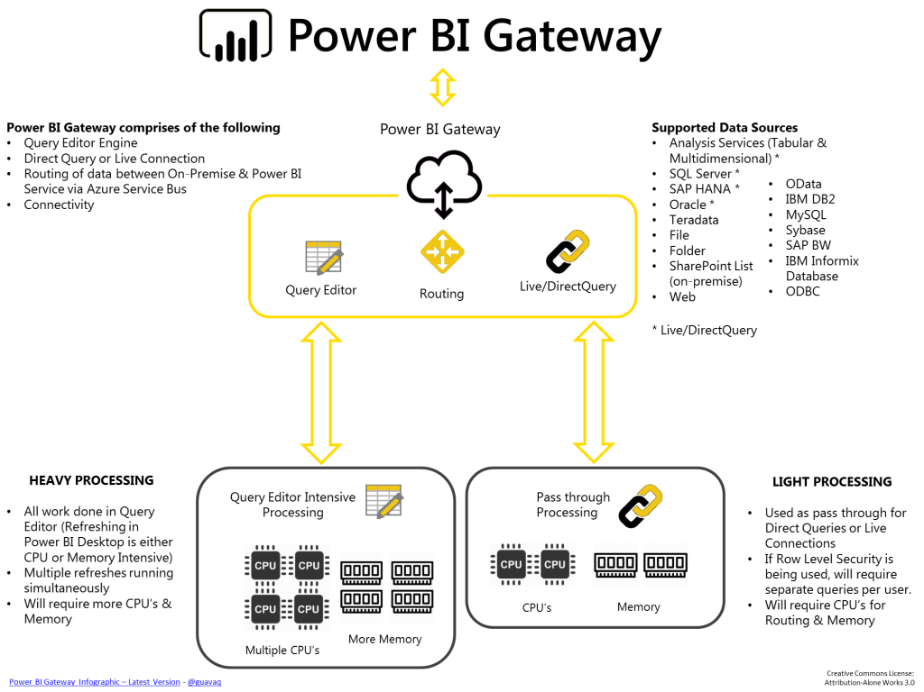
Data Analysis and Visualizations (Subjective Question) - (Cont…)

Slide 42
Data Analysis and Visualizations (Subjective Question) - (Cont…)
13. How would you approach this problem, if the objective and subjective questions weren't given?
If the objective and subjective questions weren’t given, I’d have generated one report with total revenue of the hospital. There wouldn’t be data related to patient like we have one separated tab for patient’s data. Which dept is generating how much revenue and then we will categorize it with doctor’s.
If the objective and subjective questions weren't provided, I'd focus on generating a comprehensive report detailing the total revenue of the hospital. Without specific questions guiding the analysis, I would aggregate revenue data from various departments and categorize it by department and doctor. Additionally, I would ensure that patient data is segregated in a separate tab to maintain privacy and confidentiality. This approach would provide a clear overview of which departments are contributing to the hospital's revenue and how different doctors are performing in terms of revenue generation.
Can you analyze and write the type of relationship between the doctor id and department, is it one-to-one?
It’s many to many.

Slide 43
Summarized Conclusion :
In Summary , our comprehension analysis of the hospital data has led to the development of an insightful and interactive dashboard. Key highlights include :
Patient Demographics : Clear visualization of patient age distribution, gender ratio and geographical data enabling target healthcare initiates.
Visit by Department Referral : Total number of visits to each department based on referrals to understand which departments are most frequently visited.
Operational Metrics : Detailed tracking of bed occupancy rates ,average length of stay and patient discharge processes facilitating operational efficiency.
Financial Overview : Analysis of revenue streams , cost management aiding in financial planning and sustainability.
Quality of Care : Metrics on patient satisfaction , waiting time, male-female rations and treatment outcomes ensuring continuous improvement in care quality.
Below Dashboard serves as a powerful tool for hospital administrators and staff promoting data-driven decisions-making and enhancing overall hospital performance. The integration of real-time data updates will further ensure that the insights remain relevant and actionable.

Slide 44
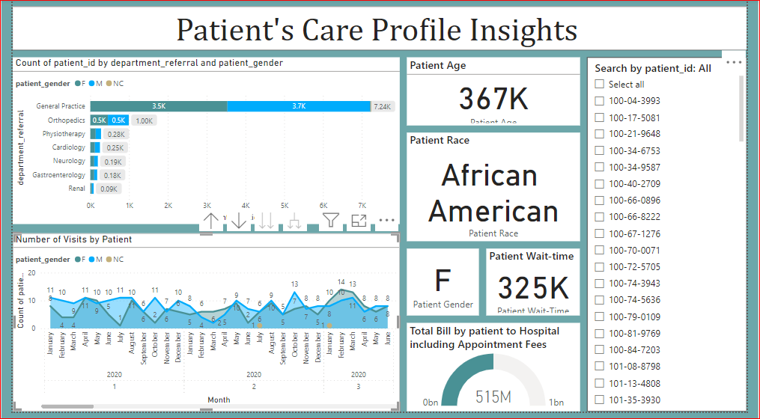

Slide 45
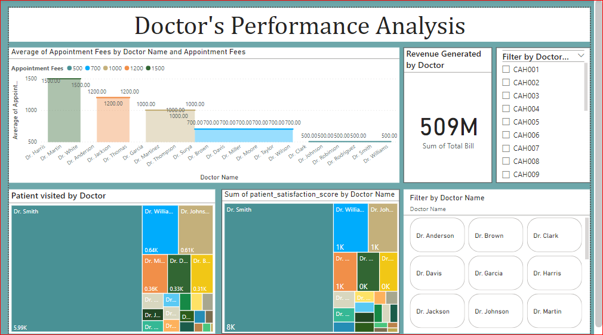

Slide 46
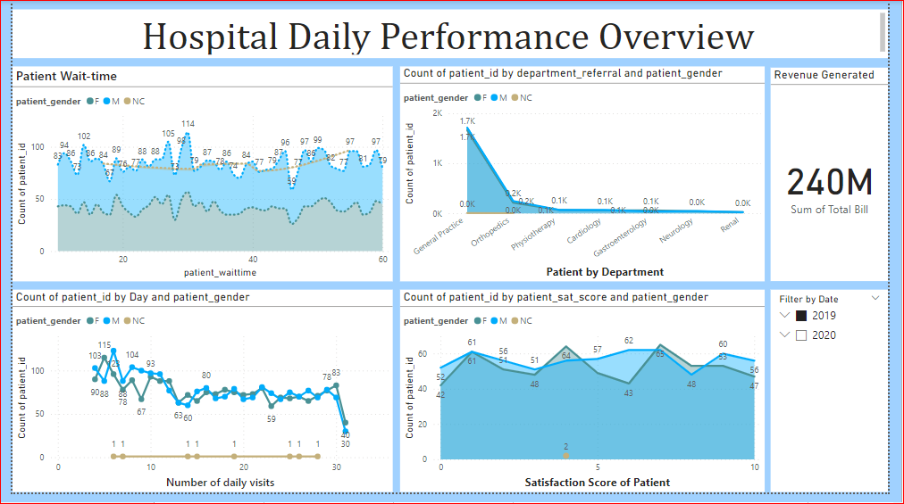

Slide 47


